Slide 1
OPERATOR OVERLOADING
The operator keyword
• Converting between basic and user-defined types
• Overloading unary operators
• Thoughts on overloading
• Overloading binary operators
• Constructors as conversion routines

Slide 2
Overloading Unary Operators
Unary operators act on only one operand. (An operand is simply a variable acted on by an operator.) Examples of unary operators are the increment and decrement operators ++ and --, and the unary minus, as in -33.
In the COUNTER example in Chapter 6, “Objects and Classes,” we created a class Counter to keep track of a count. Objects of that class were incremented by calling a member function.
c1.inc_count();
That did the job, but the listing would have been more readable if we could have used the increment operator ++ instead:
++c1;
All dyed-in-the-wool C++ (and C) programmers would guess immediately that this expression increments c1.

Slide 3
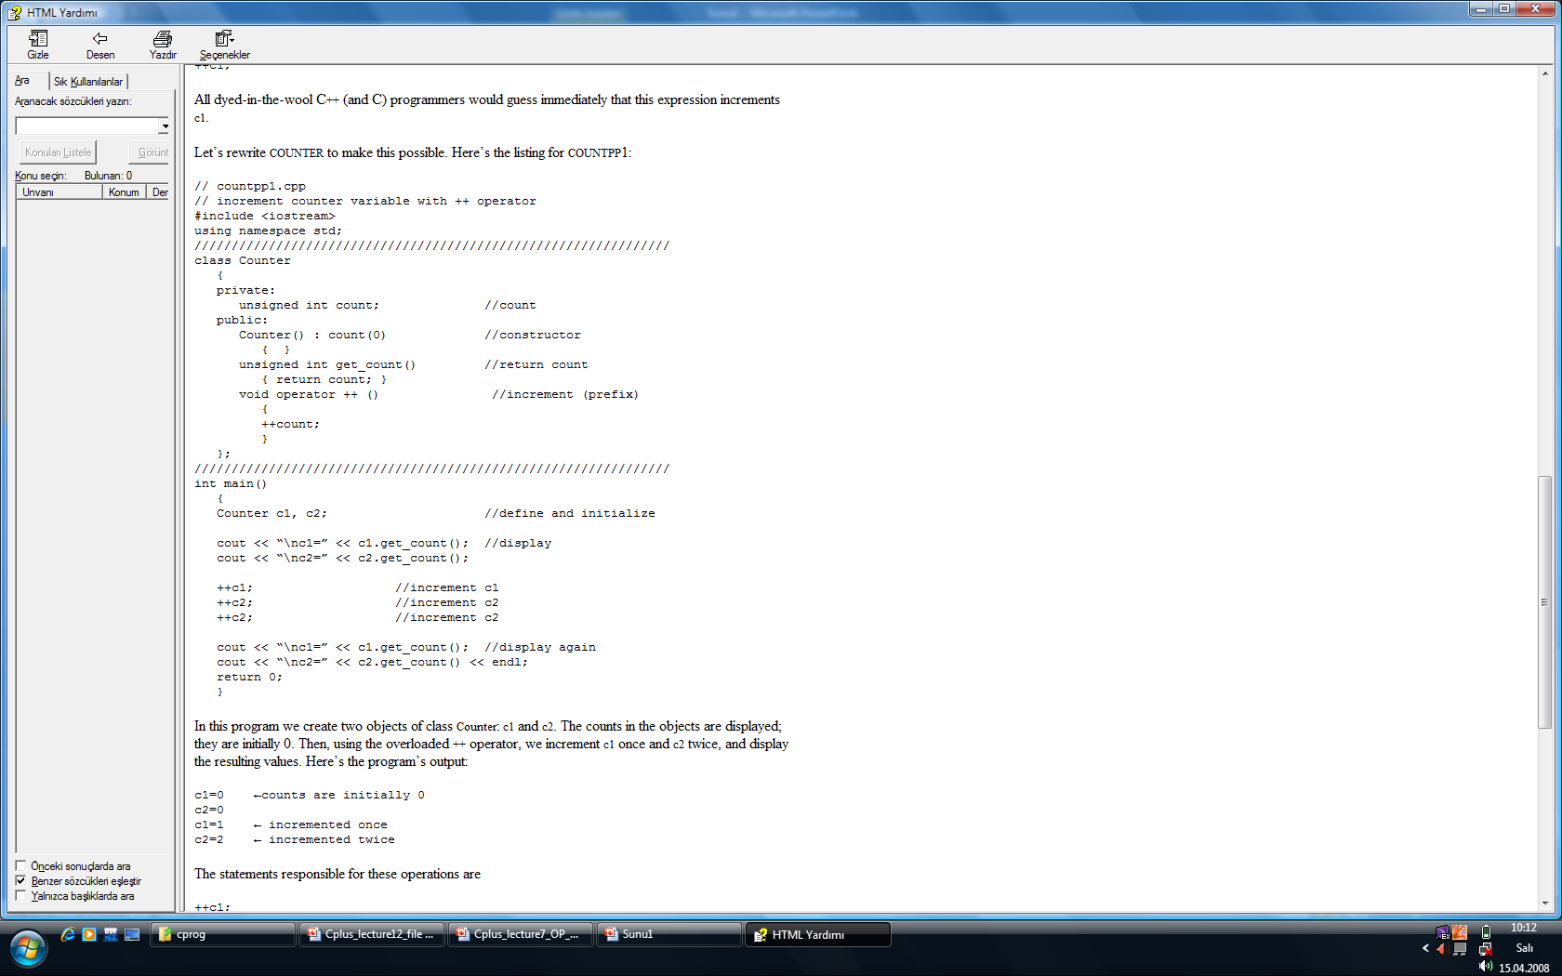

Slide 4
The operator Keyword
The keyword operator is used to overload the ++ operator in this declarator:
void operator ++ ()
The return type (void in this case) comes first, followed by the keyword operator, followed by the operator itself (++), and finally the argument list enclosed in parentheses (which are empty here). This declarator syntax tells the compiler to call this member function whenever the ++ operator is encountered, provided the operand (the variable operated on by the ++) is of type Counter.
We saw in Chapter 5, “Functions,” that the only way the compiler can distinguish between overloaded functions is by looking at the data types and number of their arguments. In the same way, the only way it can distinguish between overloaded operators is by looking at the data type of their operands. If the operand is a basic type like an int, as in
++intvar;
then the compiler will use its built-in routine to increment an int. But if the operand is a Counter variable, then the compiler will know to use our user-written operator++() instead.

Slide 5
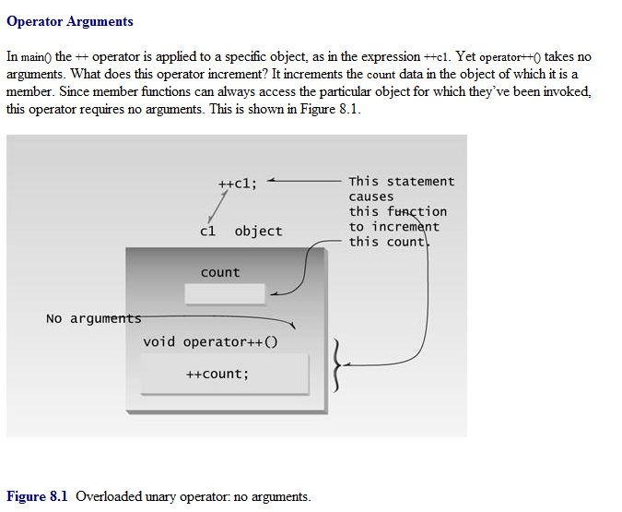

Slide 6
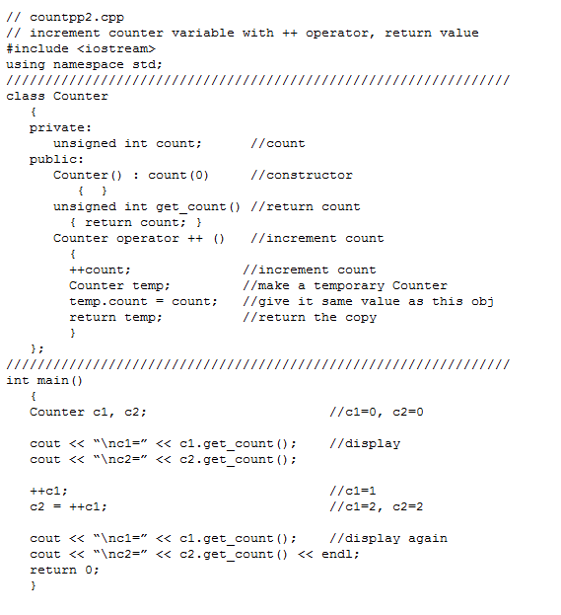

Slide 7
Postfix Notation
So far we’ve shown the increment operator used only in its prefix form.
++c1 What about postfix, where the variable is incremented after its value is used in the expression?
c1++ To make both versions of the increment operator work, we define two overloaded ++ operators, as shown in the POSTFIX program:

Slide 8
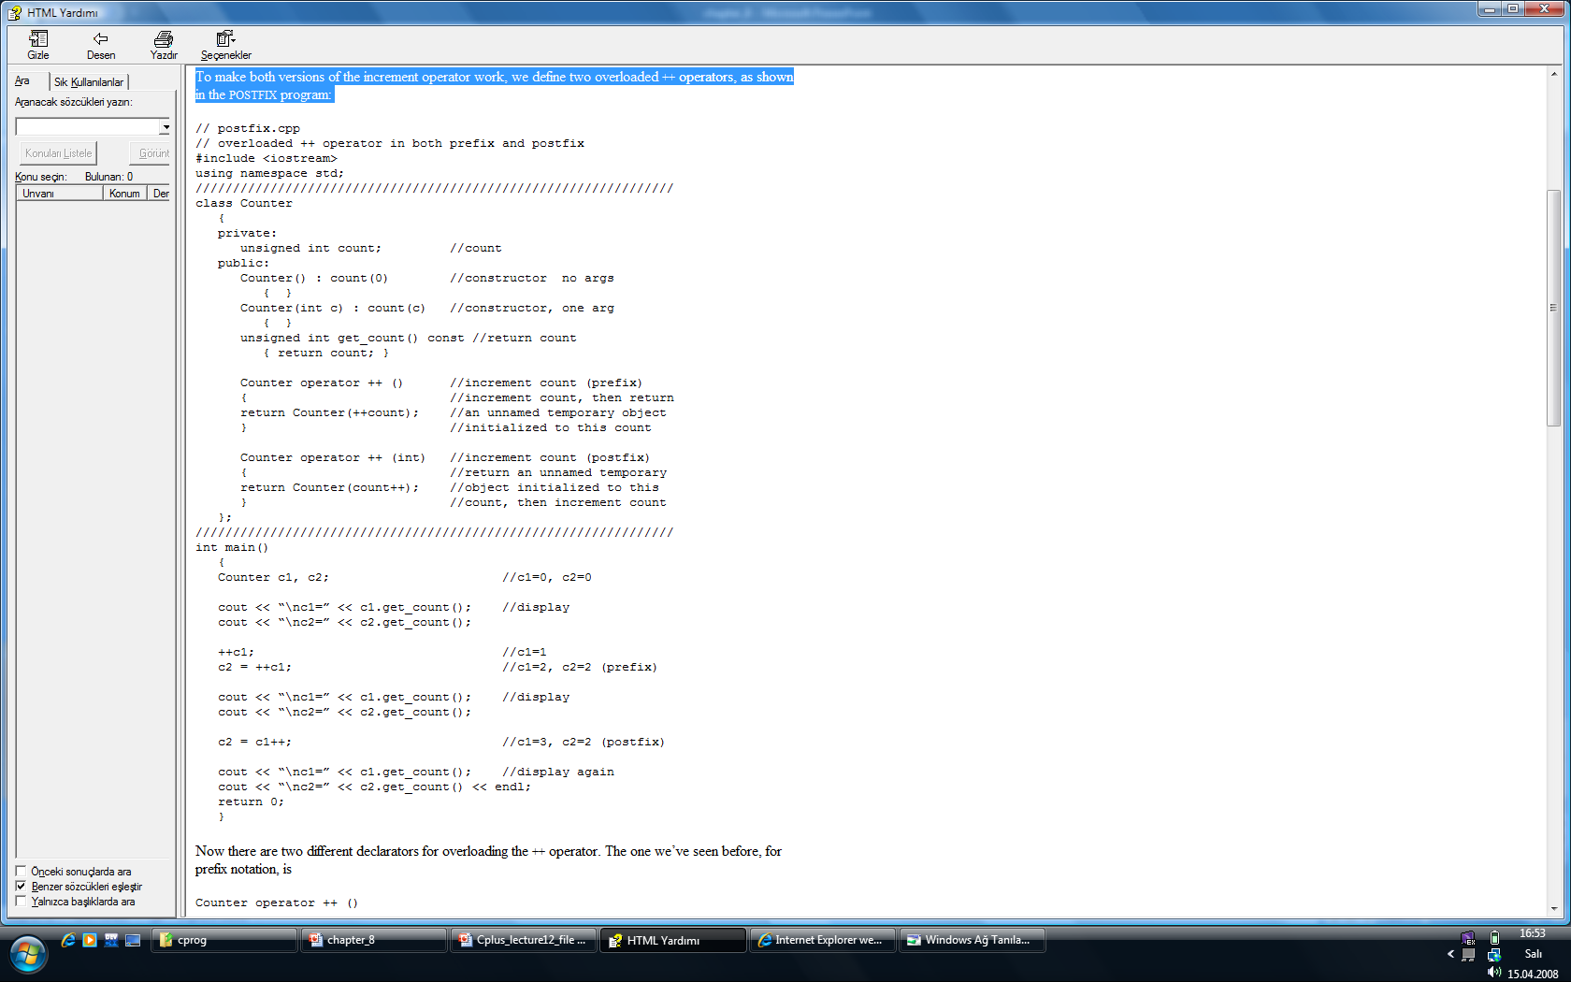

Slide 9
Overloading Binary Operators
Binary operators can be overloaded just as easily as unary operators. We’ll look at examples that overload arithmetic operators, comparison operators, and arithmetic assignment operators.
Arithmetic Operators
In the ENGLCON program in Chapter 6 we showed how two English Distance objects could be added using a member function add_dist():
dist3.add_dist(dist1, dist2);
By overloading the + operator we can reduce this dense-looking expression to
dist3 = dist1 + dist2;

Slide 10
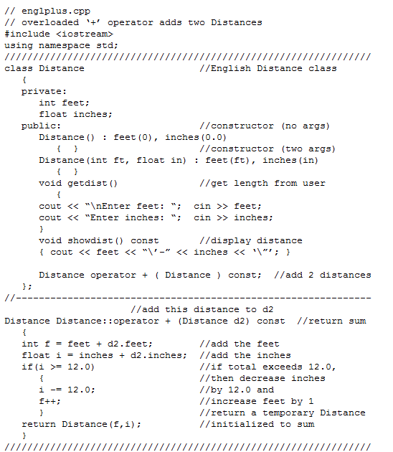
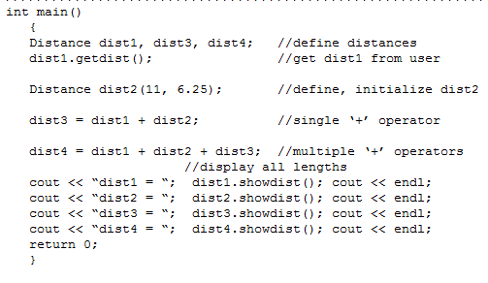

Slide 11
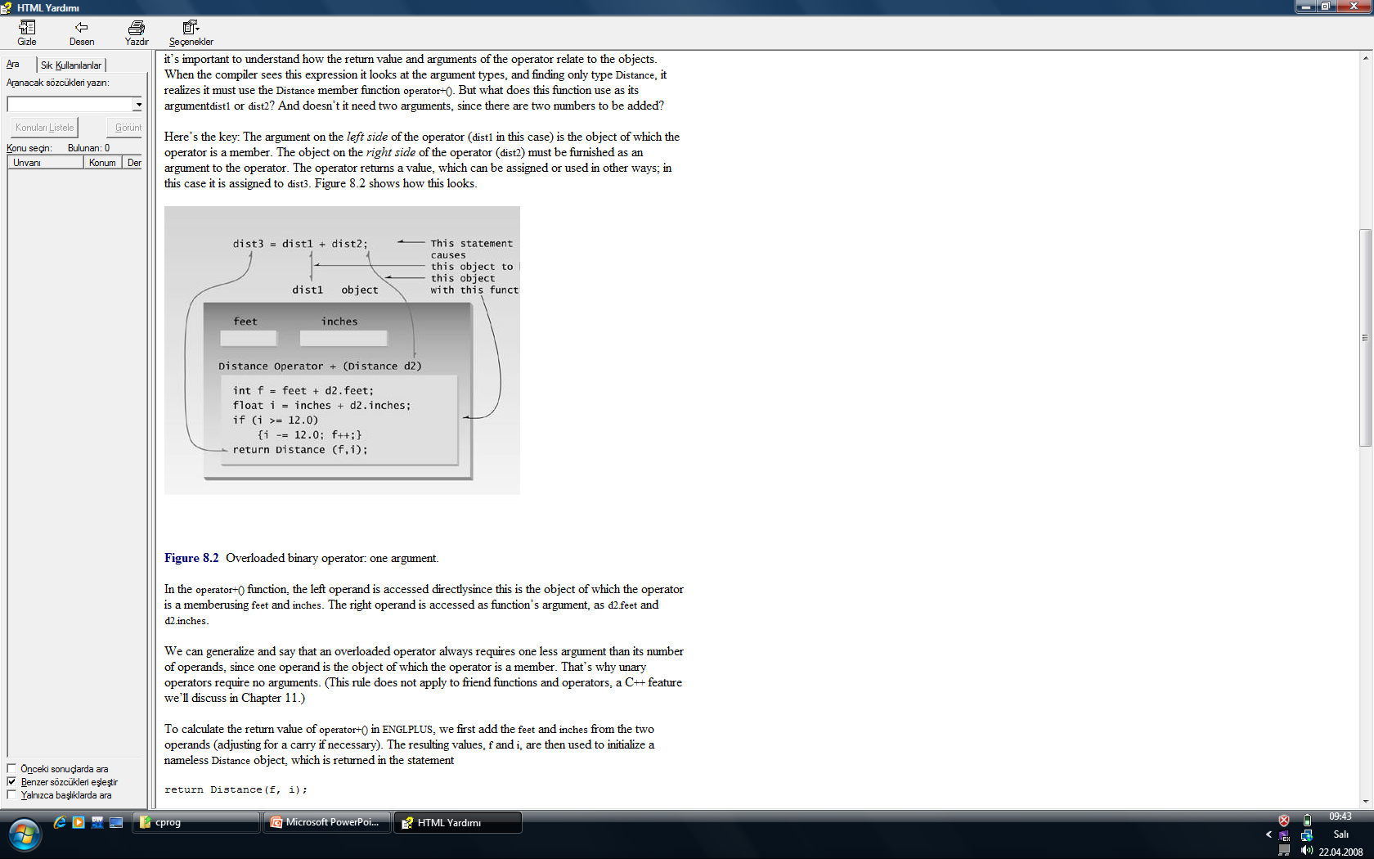

Slide 12
Concatenating Strings
you can’t say
str3 = str1 + str2;
where str1, str2, and str3 are C-string variables (arrays of type char), as in “cat” plus “bird” equals “catbird.”
However, if we use our own String class, as shown in the STROBJ program in Chapter 6, then we can overload the + operator to perform such concatenation.
This is what the Standard C++ string class does, but it’s easier to see how it works in our less ambitious String class. Overloading the + operator to do something that isn’t strictly addition is another example of redefining the C++ language

Slide 13
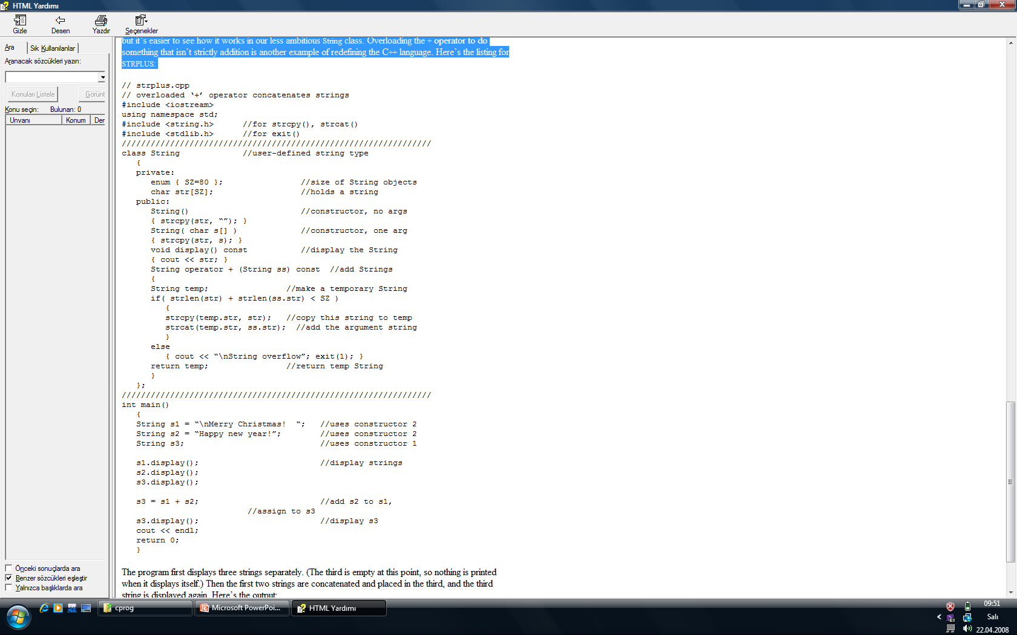

Slide 14
The program first displays three strings separately. (The third is empty at this point, so nothing is printed when it displays itself.) Then the first two strings are concatenated and placed in the third, and the third string is displayed again. Here’s the output:
Merry Christmas! Happy new year! ←s1, s2, and s3 (empty)
Merry Christmas! Happy new year! ← s3 after concatenation

Slide 15
Comparing Strings
Here’s another example of overloading an operator, this time the equal (==) operator. We’ll use it to compare two of our home-made String objects, returning true if they’re the same and false if they’re different. Here’s the listing for STREQUAL:

Slide 16
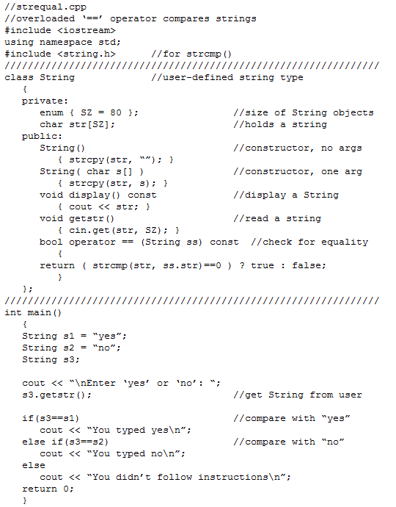

Slide 17
Arithmetic Assignment Operators
Let’s finish up our exploration of overloaded binary operators with an arithmetic assignment operator: the += operator. Recall that this operator combines assignment and addition into one step. We’ll use this operator to add one English distance to a second, leaving the result in the first. This is similar to the ENGLPLUS example shown earlier, but there is a subtle difference. Here’s the listing for ENGLPLEQ:

Slide 18
